Slide 1
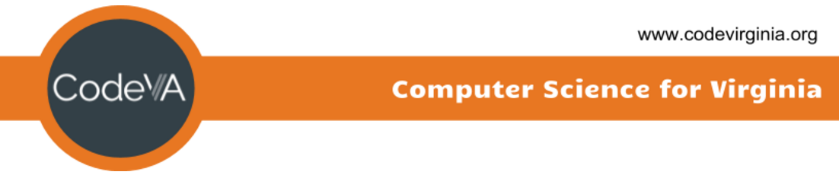
Intro to Coding
Conditionals - If Statements
Elementary Coaches Academy

Slide 2
Log into your Scratch account
https://scratch.mit.edu

Slide 3

Warm up
Open the starter File
https://scratch.mit.edu/projects/339094781/
Run the program by clicking the flag icon

Slide 4
Warm up
What control block is used after the squirrel asks if you like ice cream?
What is the other control block used?

Slide 5
Warm up
Add your own question and answer
Challenge: Add “maybe” as a possible answer to the squirrel’s ice cream question

Slide 6
Definition: Conditional
A conditional is an expression that evaluates to either true or false

Slide 7
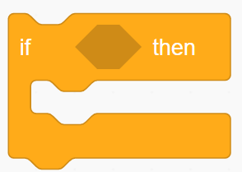
Definition: if-then
This block is used to check if an expression is true of false and then do something if the expression is true

Slide 8
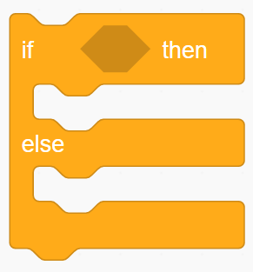
Definition: if-then-else
This block is used to check if an expression is true or false and then do something if the expression is true
Else, if the expression is false, do something else

Slide 9
Lab Lecture
Add the bowl sprite to the stage if the answer is yes
Add the winter hat sprite to the stage (on the squirrel’s head) if the answer is no

Slide 10
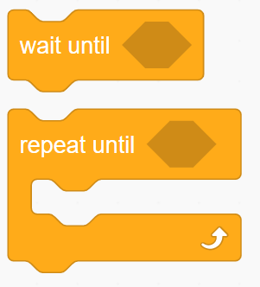
Note: other conditionals in Scratch
In Scratch, any place where you see a hexagon is where a conditional should go

Slide 11
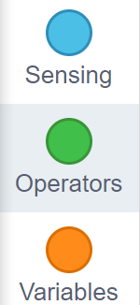
Lab Lecture
Click the Operators menu
We have all seen > (greater than), < (less than), and = (equals) in math, but we are probably not all familiar with the other hexagonal conditional operators in this menu

Slide 12

Definition: and operator
The and operator block compares the truth value of two other conditional blocks.
If they are both true, the and conditional is true, otherwise is false

Slide 13

Definition: or operator
The or operator block compares the truth value of two other conditional blocks.
If either is true, the or conditional is true, otherwise it is false

Slide 14

Definition: not operator
The not operator block checks the truth value of a single conditional.
It simply inverts the truth value of that conditional. True becomes false, false becomes true.

Slide 15
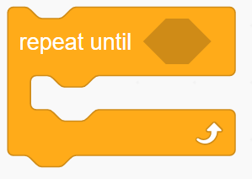
Recall: Repeat Until
Last lesson, we defined the repeat until block.
However, now we see that this block uses a conditional in the hexagonal space.

Slide 16
Discussion
Unlike in common English, in computer science, ‘or’ is considered true if both values are true.
For instance, I don’t think Patrick Henry would have been okay with both liberty AND death!
Notes:
We need to create practice exercises for teachers to try independently. *mild, Medium, spicy

Slide 17
Lab Lecture
Add the winter hat sprite to the stage (on the squirrel) if the answer is no and when the squirrel is leaving (after he asks you about ice cream)

Slide 18
Quick Reflect
Can you think of a content area in the topics that you already teach where if/else logic or conditionals could easily be integrated or is relevant?

Slide 19
Practice Exercises
LINK
Mild - perfect for beginners
Medium - expanding your skills
Spicy - looking for a challenge?

